Slide 1
Bio Energy

Slide 2
Biomass
Biomass is organic matter produced by plants, both terrestrial and aquatic and their derivatives.
It includes forest crops and residues, animal manure, Agriculture waste, Municipal and Kitchen waste, discarded material from food processing plants.
Renewable source of energy
Indirect form of solar energy

Slide 3
Biomass
Terrestrial crops include Sugar crops such as sugarcane and Sweet sorghum
Herbaceous crops, Silviculture plants such as cultured hybrid poplar, sycamore, sweet gum, Adler, eucalyptus and other hard woods.
Aquatic Crops- Grown in fresh, sea and brackish waters. Both submerged and emergent plants are considered, including sea weeds, marine algae and giant California kelp.

Slide 4
Bio-fuels
Its conversion of biomass into more useful form by variety of techniques like digestion or fermentation, Gasification, liquefaction etc.
Fuel derived from biomass are easily handled and burnt as compared to raw biomass
Biofuels- Biogas, Fuel gas, Bio-liquids
Higher calorific values

Slide 5
Bio-fuels
Three solid biofuels- Wood, Straw and Municipal refuse
Liquids- Methanol, Ethanol, Vegetables oil
Gases- Biogas, Methane, Fuel Gas

Slide 6
Energy Plantation
It is methods of Tapping Maximum solar energy by growing plants
Energy farms –Ideal solar collector, virtually no maintenance, economical and non-polluting.
Photosynthesis occurring in naturally, stores more than ten times much energy annually, in plant farm than is consumed by all mankind.
In india 23% of total land area is under forests. Area under social forestry of quick growing trees has increased.
Jojaba an ever shrub around 1.7 m in height grows wild in semi-arid region of Mexico and USA. Its seeds contain 50-80 of oil.
The tree species namely Acacia, Tortilla, Albizzia, Lebbak, Prasois, Juliflora likewise have been identified adapted to hot-arid regions in our country.

Slide 7
Biomass conversion
Direct combustion
Thermochemical conversion
Gasification
Liquefaction
Biochemical conversion
Anaerobic digestion
Fermentation

Slide 8
Direct combustion
Direct combustion, such as wood waste and bagasse

Slide 9
Thermochemical conversion
Gasification
Takes place by heating the biomass with limited oxygen to produce low heating value gas or by reacting it with steam or oxygen at high pressure and temperature to produce medium calorific value gas.
Ex. Downdraft Gasifier, Updraft Gasifier
Liquefaction
Liquid yields are maximized by rapid heating of the feedstock to comparatively low temperatures. The vapors are condensed from the gas stream and these separates into a two phase: the aqueous phase (pyroligneous acid) contains a soup of water soluble organic materials like acetic acid, acetone and methanol, the non-aqueous phase consists of oils and tars. These crude product can be burnt (with some difficulty), but it is usually more profitable to upgrade to premium fuels by conventional refining techniques.

Slide 10
Biochemical conversion
Anaerobic digestion
Involves the microbial digestion of biomass.
An anaerobe is a micro-organism that can live and grow without air or oxygen, it gets its oxygen by the decomposition of matter containing it.
Fermentation
It is the breakdown of complex molecules in organic compound under influence of a ferment such as yeast, bactaria, etc.
It is a well established and widely used technology for the conversion of grains and sugar crops into ethanol.

Slide 11
Wet Process and Dry process
Wet Process
Anaerobic digestion
Fermentation
Chemical reduction – It involves pressure-cooking animal wastes or plant cellulosic slurry with an alkaline catalyst in the presence of CO at temperature between 250°C to 400°C.
Dry process
Pyrolysis – A wide range of energy rich fuels can be produced by roasting dry woody matter like straw and wood chips. Cellulose and lignin break down to simpler substance. Produce charcoal.
Liquefaction
Gasification

Slide 12
Photosynthesis
The most important chemical reaction on the earth is the reaction of sunlight and green plants.
Radiant energy of sun is absorbed by the green pigment chlorophyll in the plant and is stored within the plants in the form of chemical bond energy.

Slide 13
Biogas Generation
Introduction
Anaerobic Digestion
Acid Formation
Methane formation
Advantages of anaerobic digestion

Slide 14
Factors affecting on gas Generation Rate
pH
Temperature
Total solid content of feed material
Loading rate (0.5 to 1.6 kg of volatile solid per m³)
Seeding
Uniform feeding
Diameter to depth ratio (0.66 to 1)
C to N ratio (C use for energy and N use for building the cell structure )
Nutrients (P – Night soil & N₂ chopped leguminous plants )
Mixing or stirring
Retention time
Types of feedstocks
Toxicity due to end product
Pressure
Acid accumulation inside the digester (neem cake)

Slide 15
Classification of Biogas plant
Continuous or batch types
Dome and drum type
Floating dome type
Fixed dome type
Different variations in drum type

Slide 16
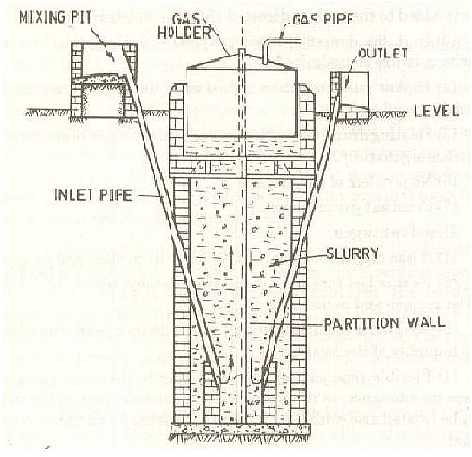
Floating Dome type biogas plant (KVIC Digester)

Slide 17
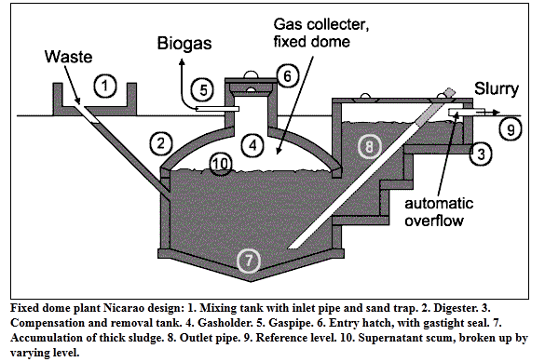
Janta biogas plant

Slide 18
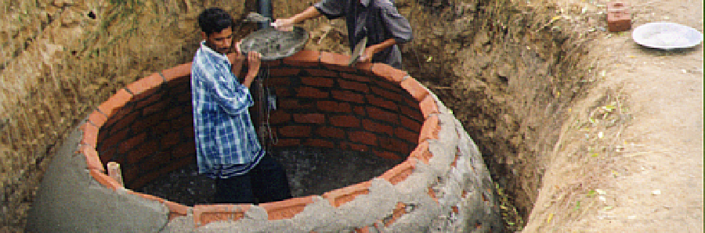
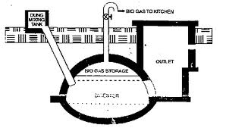
Deenbandhu Biogas Plant

Slide 19
The following data are given for a family biogas digester suitable for the output of five cows: the retention time is 20 days, temperature 30°C, dry matter consumed per day=2 kg/ Cow, biogas yield is 0.24m³/kg. The efficiency of burner is 60%, methane proportion is 0.8. Heat of combustion of Methane = 28 MJ/m³. Find: (1) the volume of biogas digester (2) the power available from the digester Assume ρ_{m} = density of dry material in the fluid = 50 kg/m³

Slide 20
Mass of the dry input m_{o} = 2 kg/day*5 = 10 kg/day Fluid volume V_{f}=m_{o}/ρ_{m} = 10 (kg/day)/50(kg/m³) = 0.2 m³/day Digester volume V_{d}=V_{f}*t_{r}= 0.2*20 = 4 m³ Volume of biogas V_{b}=biogas yield input*mass of dry input = 0.24*10 = 2.4 m³/day The Power available from the digester E=ή*H_{m}*M_{p}*V_{b} =0.6*28*0.8*2.4 =32.25 MJ/day=8.95 kWh/day = 370 W (continuous thermal)

Slide 21
Calculate the volume of a fixed dome type biogas digester for the output of two cows. Also, calculate the thermal power available from biogas. Use the following data: Retention time = 30 days Dry matter produced = 2 kg/day/cow biogas yield = 0.22 m³/kg of dry matter % of dry matter in cow dung = 18% Density of slurry = 1090 kg/m³ Burner efficiency = 60% Heating value of biogas = 23 MJ/m³

Slide 22
Dry matter produced by two cows = 2*2 = 4 kg/day A dry matter content in cow dung is only 18%, cow dung produced = 4/0.18 = 22.22 kg/day

Slide 23
Equal quantity of water is added to make the slurry. The amount of slurry produced per day = 44.44 kg/day Slurry volume produced per day = 44.44/1090 = 0.04077 m³/day

Slide 24
With retention time of 30 days, total slurry in digester = 30*0.04077 = 1.223 m³ As about 15% digester area is occupied by the gas, the net digester size = 1.22/0.85 = 1.44 m³

Slide 25
Gas produced = 4*0.22 = 0.88 m³/day Thermal Energy available = 0.88*23*0.6 = 12.144 MJ/day Continuous thermal power available =140.55 W

Slide 26
Example-3
Determine the volume of a cow dung based biogas plant required for cooking needs of a family of four adults and lighting needs with three 100 CP lamps for three hours daily. Also, Determine the required number of cows to feed the plant. Assume standard values of data where required.
Solution: Assume biogas per person = 0.227 m³/day
Biogas for lamp= 0.126 m³/hr
Assume no of cow=n
Dung produced=10 kg/day/cow, Collective cow dung=70%
Gas yield= 0.34 m³/kg of dry mass
Total Gas production

